Slide 1
EagleSat 2: Scientific Payloads’ Overview and Developments
April 14, 2018
by
Jason Hamburger

Slide 2
Outline
Cosmic Ray Payload (CRP)
Mission Overview
Hardware Selection
Prototyping
Testing
Memory Degradation Experiment (MDE)
Mission Overview
Hardware Selection
Prototyping
Testing

Slide 3
Cosmic Ray Payload (CRP)

Slide 4
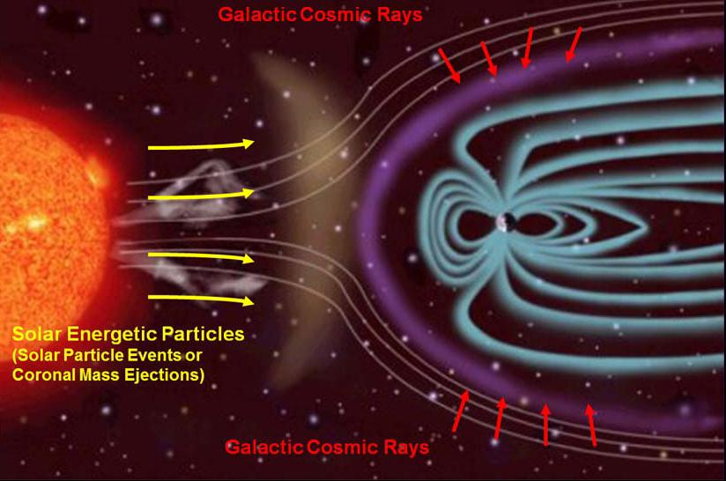
CRP – Mission Overview
Objective – to detect incoming cosmic ray particles and determine their direction and magnitude.
Types of Cosmic Rays:
Solar:
Energy Levels: 10⁷ to 10⁸ eV
Origin: Corona of the Sun
Anomalous
Energy Levels: 10⁷ to 10⁸ eV
Origin: Ionized interstellar atoms
Galactic
Energy Levels: 10¹⁰ to 10¹⁵ eV
Origin: Shocks of supernovas
Notes:
Determine cosmic ray characteristics through image processing of the pixels
Solar Cosmic Rays
Energy Levels: 10⁷ to 10⁸ eV
Origin: Corona of the Sun
Anomalous Cosmic Rays
Energy Levels: 10⁷ to 10⁸ eV
Origin: Ionized neutral interstellar atoms
Galactic Cosmic Rays
Energy Levels: 10¹⁰ to 10¹⁵ eV
Origin: Shocks of supernovas

Slide 5
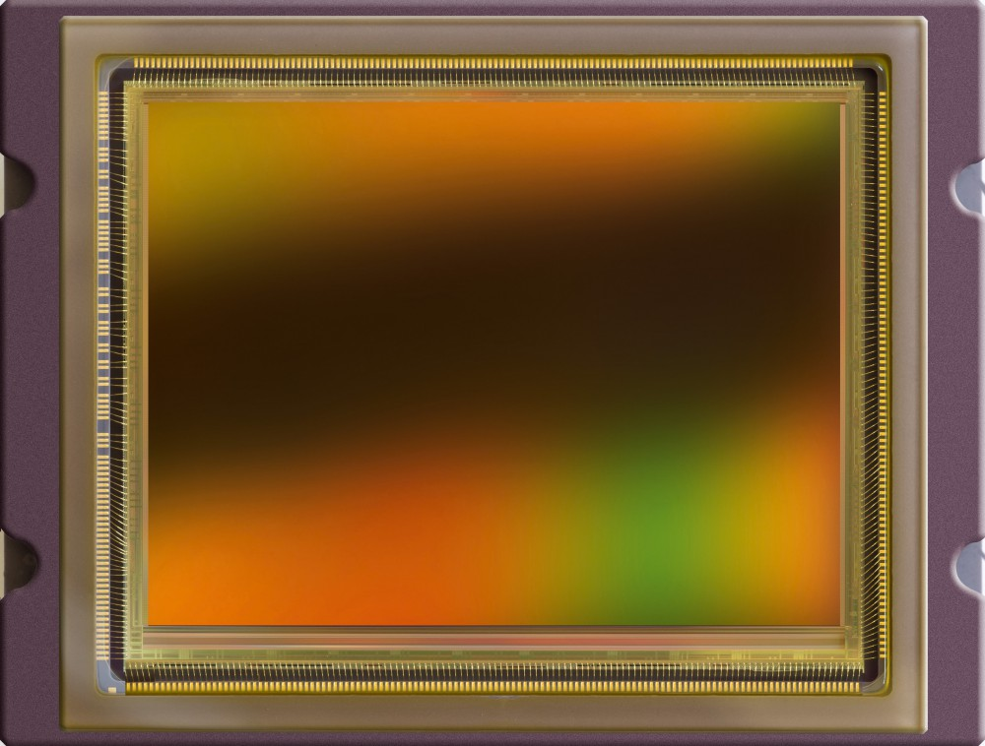
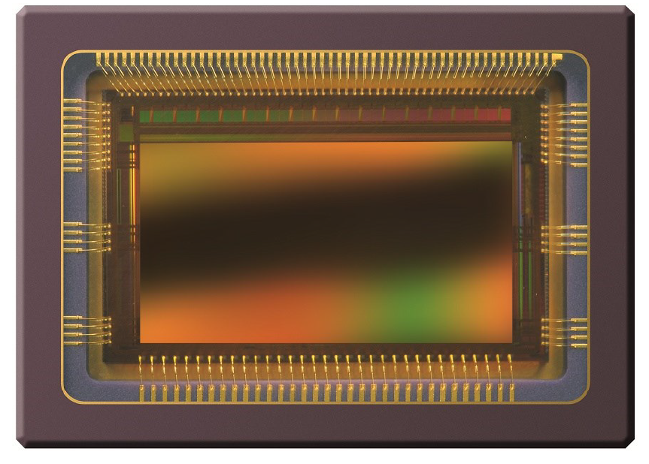
CRP – Hardware Selection
CMV50000
Flight Selection
CMV2000
Preliminary Test Model
Advantages:
LVDS connections
Inexpensive
Large detection area (2048 by 1088 pixels)
Small pixel size (5 µm x 5 µm)

Slide 6
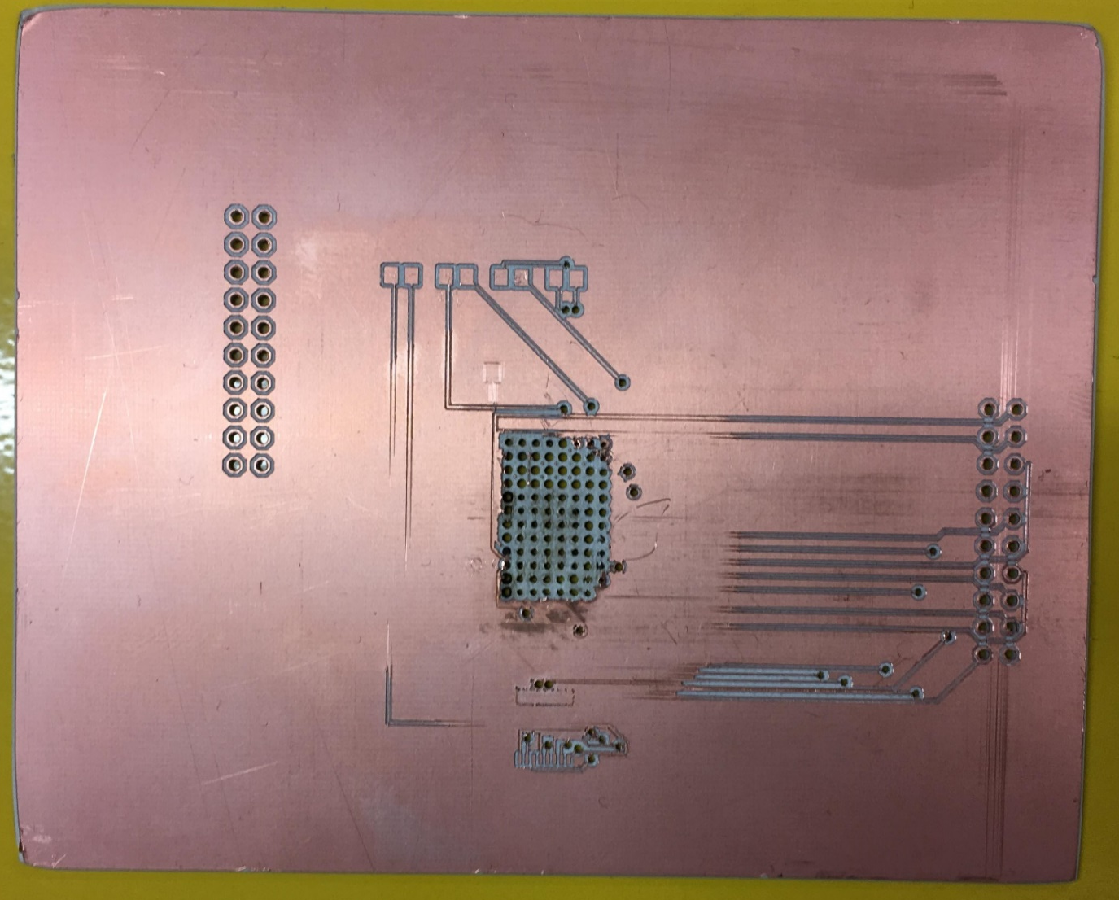
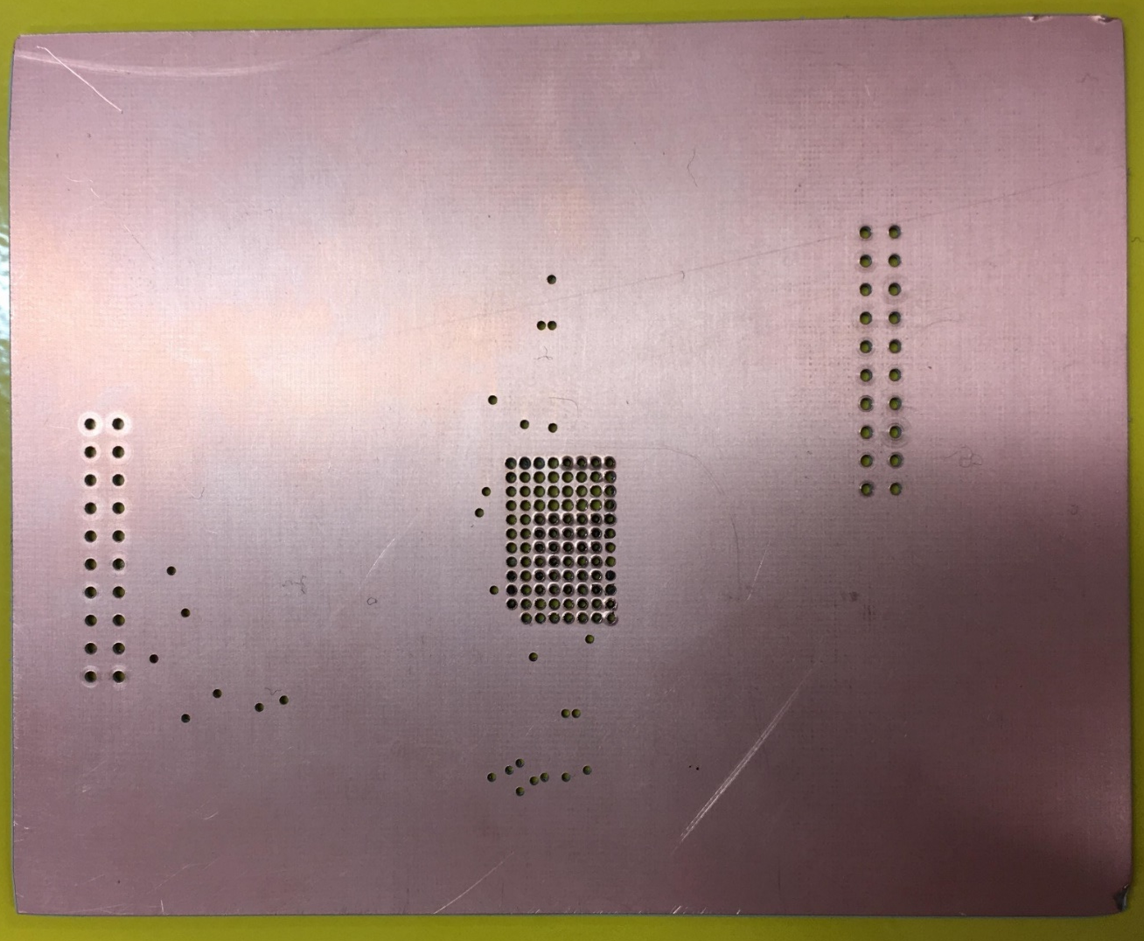
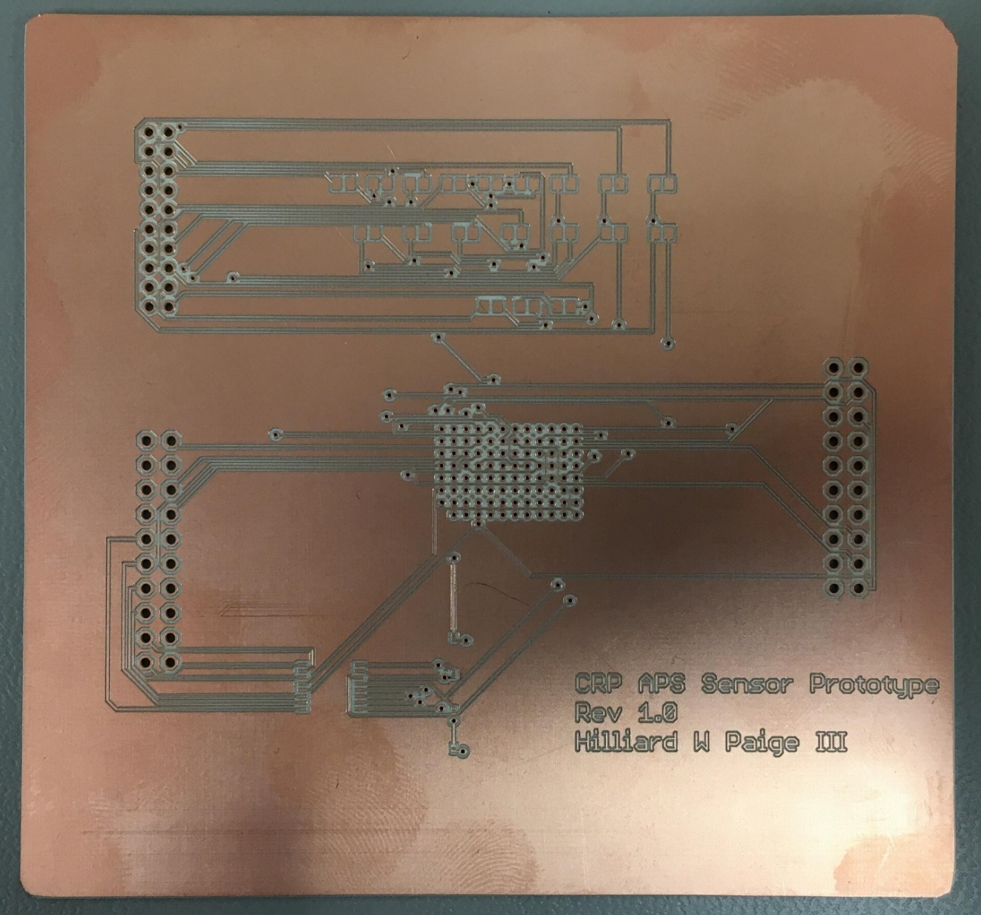
CRP – Prototyping (Issues)

Slide 7
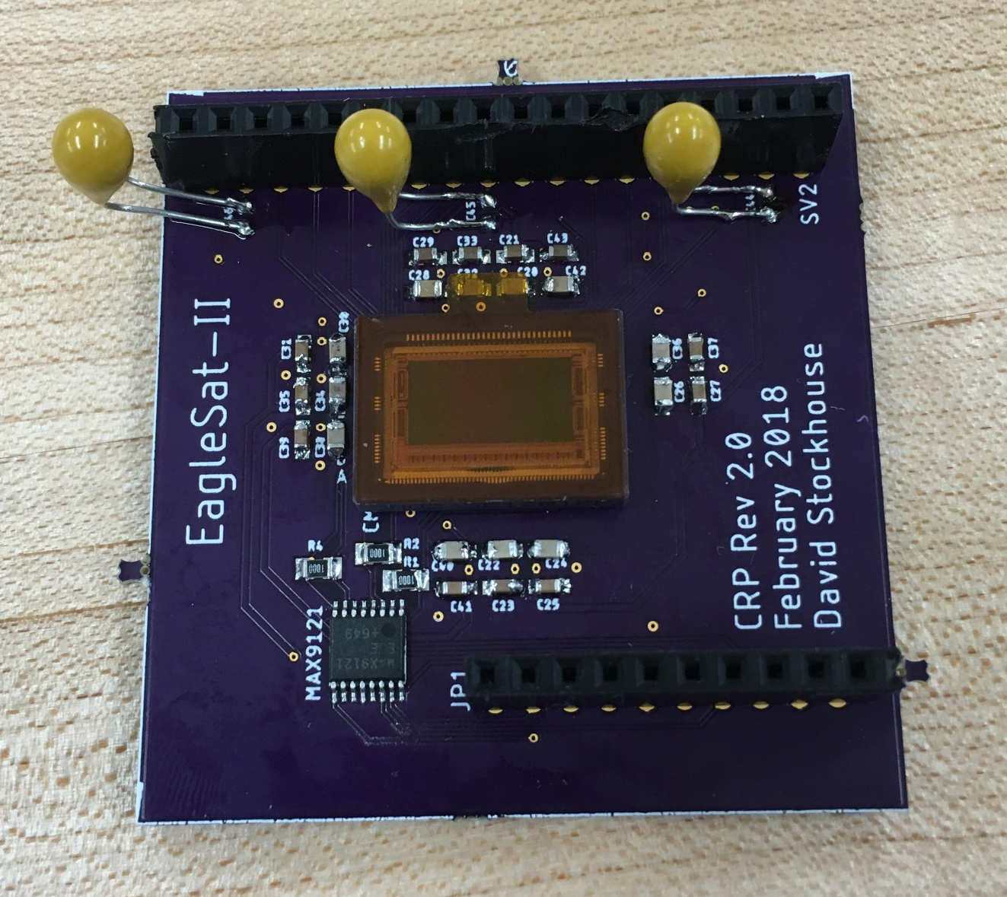
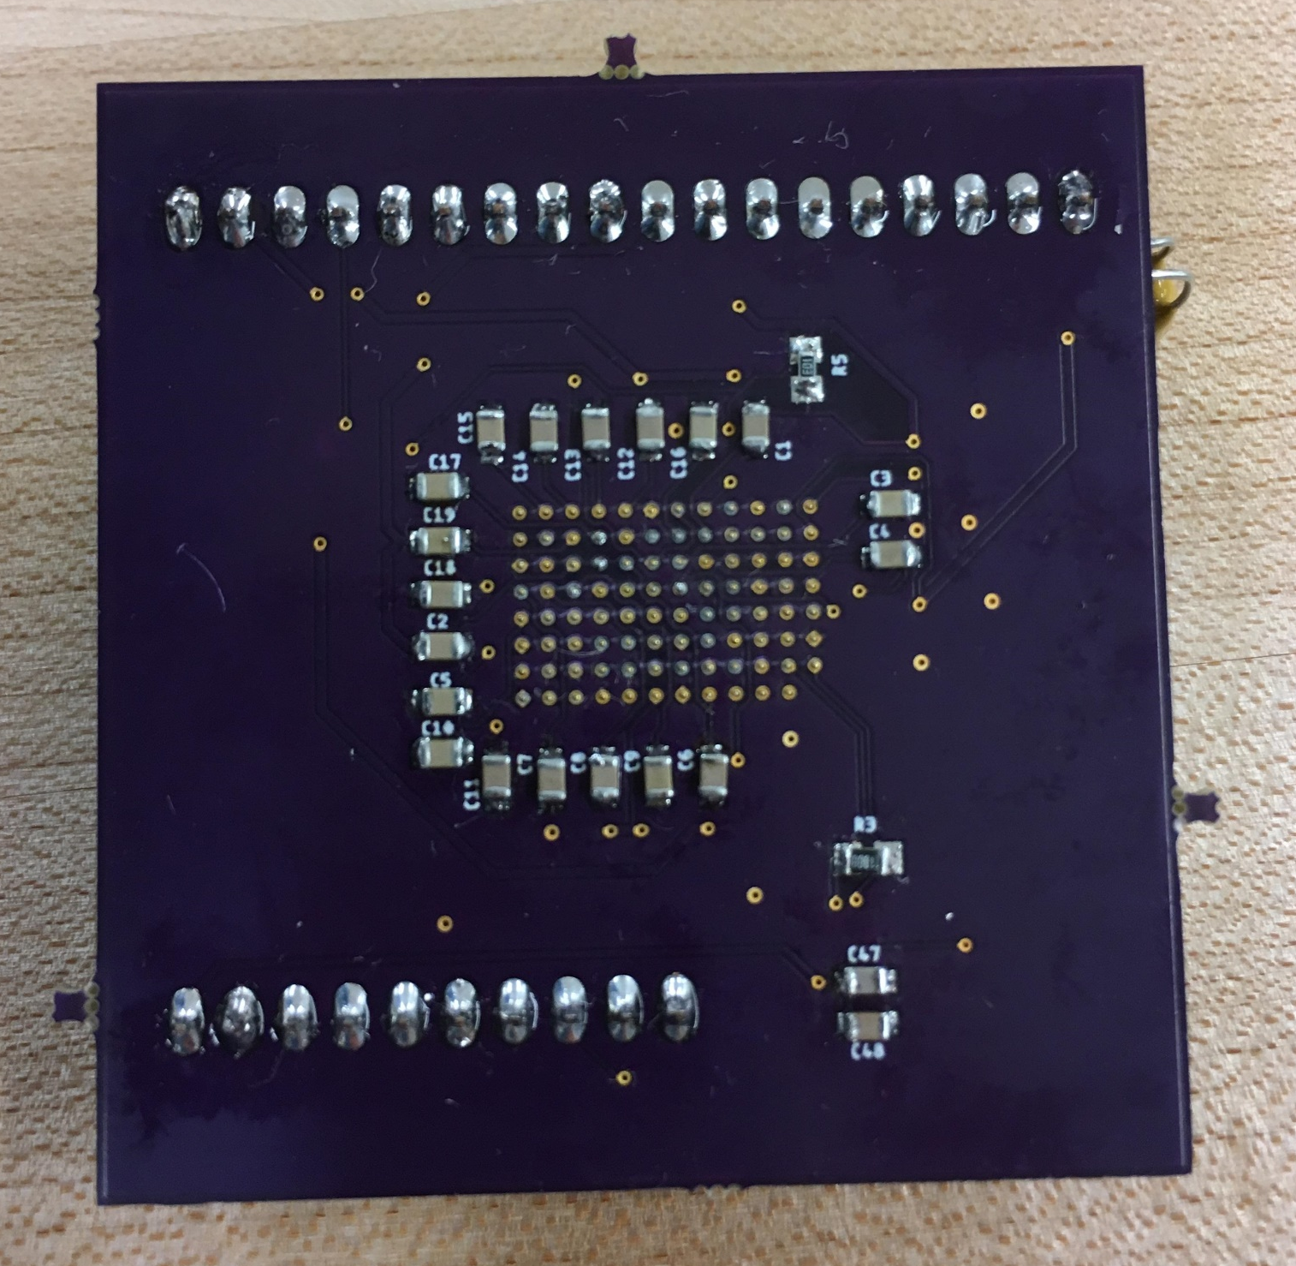
CRP – Prototyping

Slide 8
CRP – Testing
Plugs-In Test
Plugs-Out Test
Balloon Test

Slide 9
Memory Degradation Experiment (MDE)

Slide 10
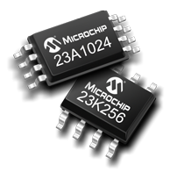
MDE – Mission Overview
Detect bit flipping and memory degradation caused by solar radiation
Commercially available, consumer grade memory
Flash
SRAM – Static Random Access Memory (RAM)
FRAM – Ferroelectric RAM
MRAM – Magnetic RAM
EEPROM – Electrically Erasable Programmable Read-Only Memory

Slide 11
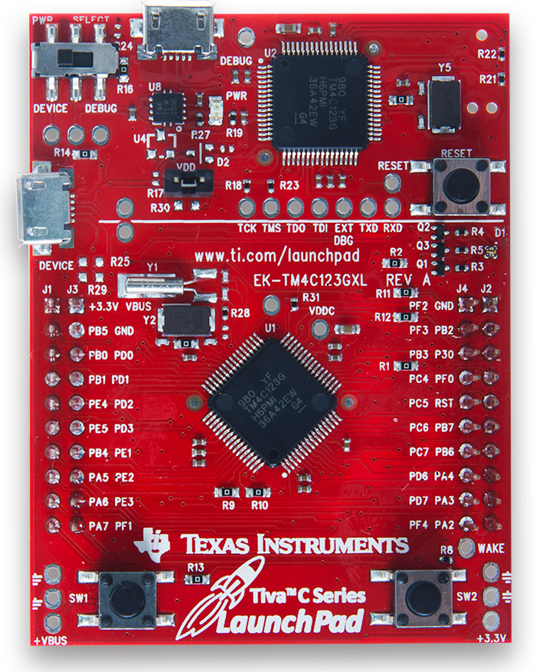
MDE – Hardware Selection
Microprocessor
TM4C
Flash
SST25VF020
SRAM
25LC1024
FRAM
FM24V10-G
MRAM
MR25H10MDC
EEPROM
BR25A1MF
Notes:
Should I put the individual trade studies in the backup slides?

Slide 12
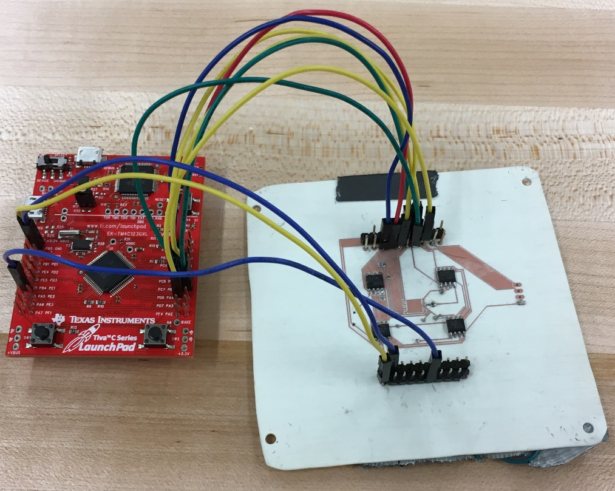
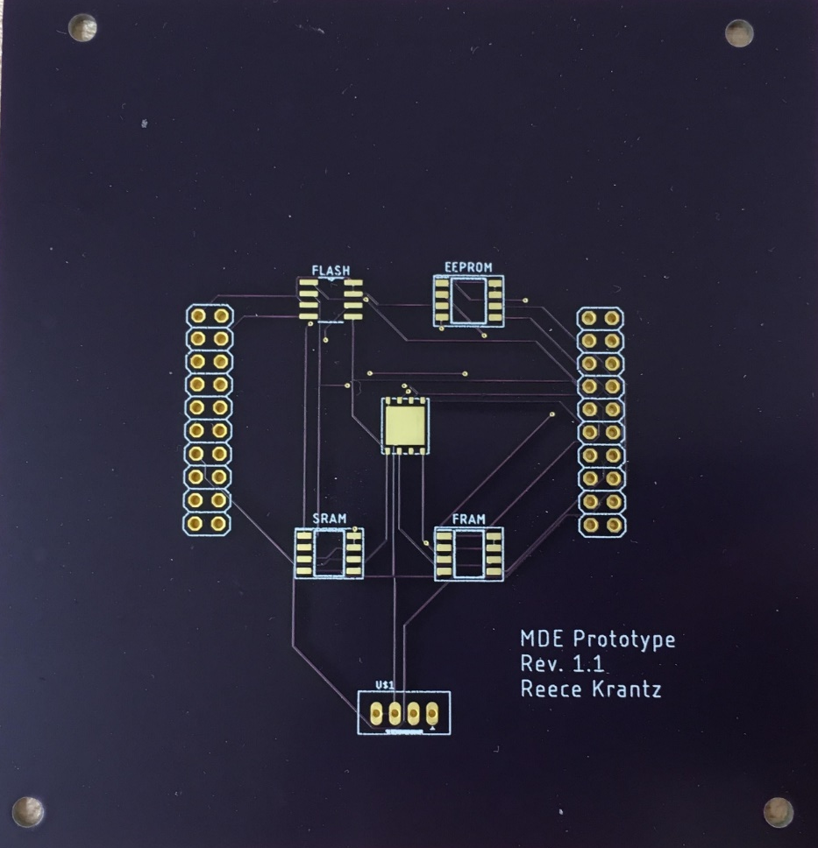
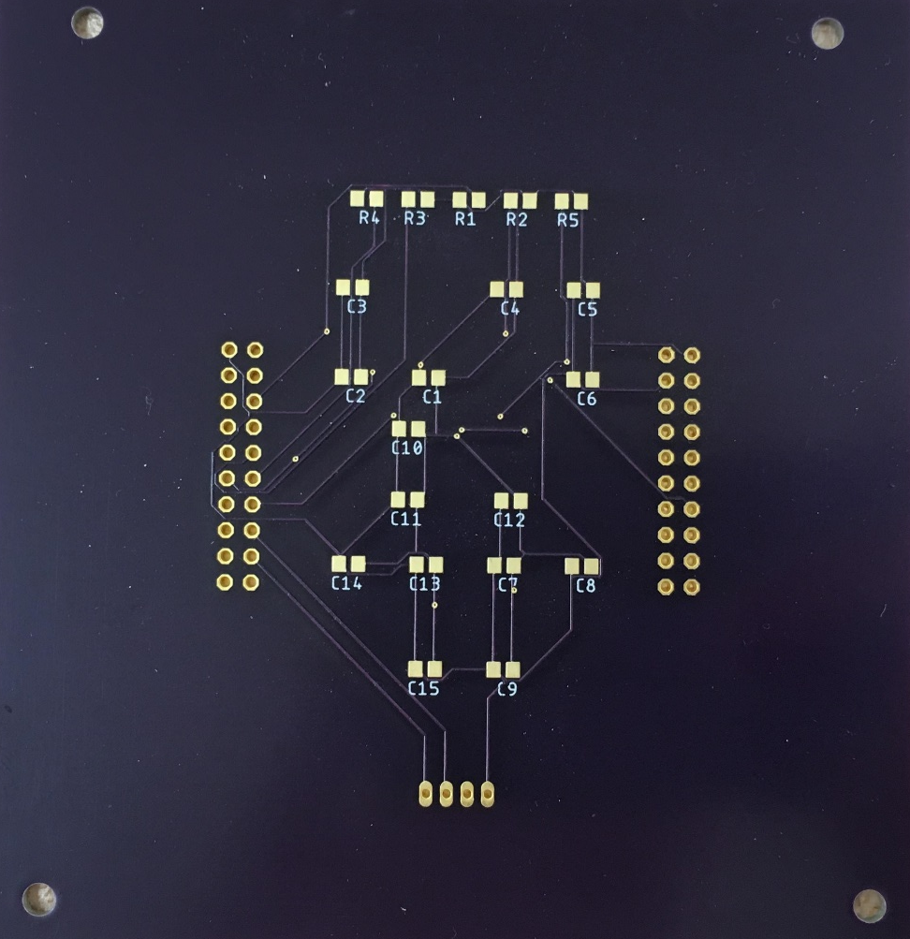
MDE – Prototyping

Slide 13
MDE – Testing
Plugs-In Test
Plugs-Out Test
Balloon Test
Notes:
Plugs- In

Slide 14
Questions?
Jason Hamburger
hamburj1@my.erau.edu

Slide 15
Back-Up Slides (CRP)

Slide 16
CRP – Sensor Requirements
Weigh no more than 0.50 kg
Draw no more than 1.0 W
Not exceed dimensions of 9.5 cm x 9.5 cm x 6 cm (x,y,z)
Individual pixel dimensions not exceed 48 µm x 48 µm (x,y)
Operate between -20°C and +60°C
Output a maximum of 5.5 Mb of data per orbit

Slide 17
CRP – Sensor and Operation
CMOS Image Sensor
Capture event – pixels hit by cosmic ray particle
Determine cosmic ray characteristics through image processing of the pixels
Operation
Take 10 exposures with 1 second between exposures
5-second exposure
5 cycles in one orbit
~1.1 Mb per data collection cycle

Slide 18
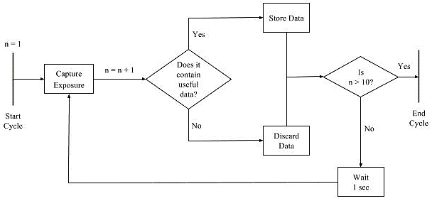
CRP – Science Collection Algorithm

Slide 19
Back-Up Slides (MDE)

Slide 20
MDE – Payload Requirements
Weigh no more than 0.10 kg
Draw no more than 0.2 W
Not exceed dimensions of 9.5 cm x 9.5 cm x 2.5 cm (x,y,z)
Operate between -20°C and +60°C
Output a maximum of 0.2 Mb of data per orbit

Slide 21
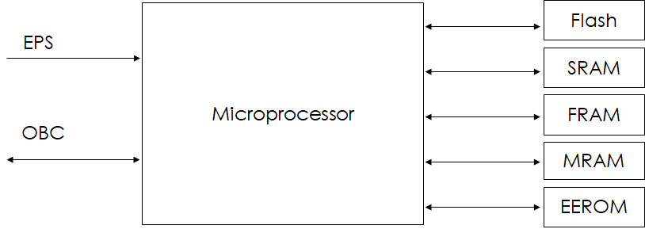
MDE – Hardware Block Diagram
EPS, 3.3 V
OBC
SPI

Slide 22
MDE – Main Algorithm

Slide 23
MDE – Function: Determine Errors

